Slide 1

AI-Based Conversational Assistant for Healthcare Support
MTech in Information Technology (AI)
Presented By
Student name : Raja Biswas
Roll No : 30060924009
Registration No : 243000410770
Guided By:
Supervisor name : Dr. Nabarun Bhattacharya
Co Supervisor name : Ms. Sayani Manna
Department of Information Technology.
Maulana Abul Kalam Azad University Technology, West Bengal, India

Slide 2
1
Introduction
2
Motivation
3
Literature Reviews
Table of Contents
4
Research Gaps and Objectives
5
Proposed Methodology
6
Experimental Results
7
References

Slide 3


Introduction
1
About the Project
Large language models (LLMs) in artificial intelligence, showing huge capabilities in understanding and generating human-like text.
These models, developed on deep learning and natural language processing technologies, integrated into various sectors, including healthcare, where it have begun to transform various aspects of medical practice.

Slide 4
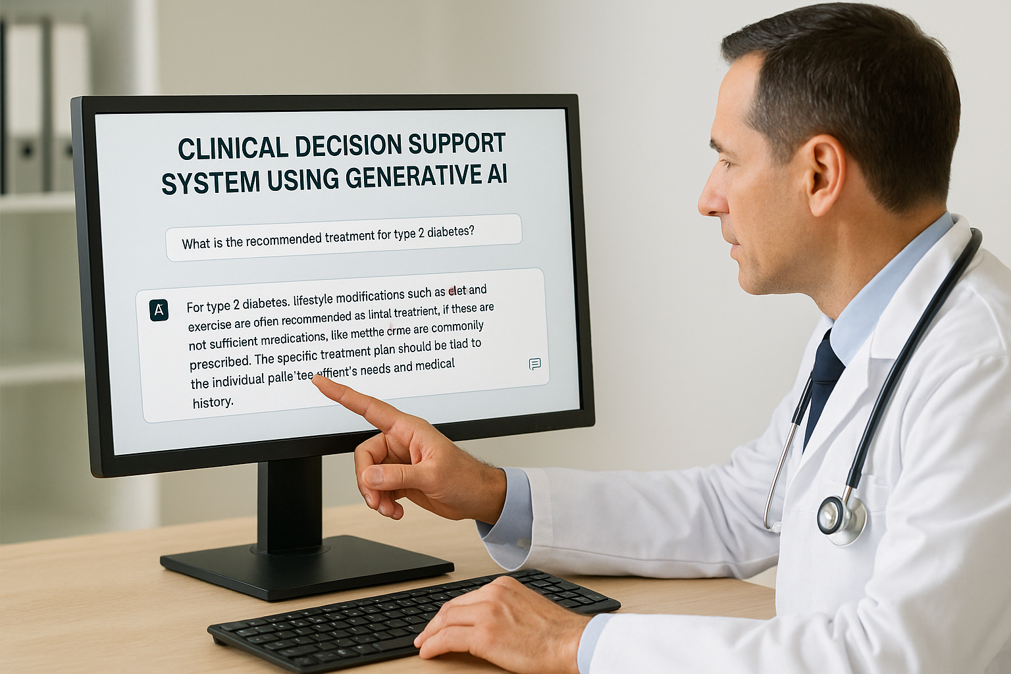
Continued
About the Project
- Use of these models to process medical information can solve critical challenges in healthcare, including information overload, documentation burden, and the need for personalized care
And can enhance real-time support for health Care.
Picture

Slide 5



2
Motivation
Challenges in Healthcare current healthcare data analysis faces many challenges. It often struggles with unstructured information.
Rule-based systems cannot adapt to evolving medical knowledge.
Need for dynamic, explainable support systems that utilize medical data.

Slide 6
4
Literature Reviews

Slide 7
4
Literature Reviews
Continued

Slide 8
3
Objective And Research gaps
Objectives :
1
To develop a multimodal AI assistant that integrates speech, vision, and language processing to support healthcare-related conversations in a user-friendly interface.
2
To allow analyze medical images (e.g., wounds, burns, cuts) and generate descriptive, non-diagnostic observations for educational and supportive purposes.
3
To fine-tune large language models (LLaMA/Med Gemma) on healthcare-related datasets, adapting them for safer, domain-specific conversational assistance.

Slide 9
Major Research Gaps :
Continued
Lac of Structured Data
Ethical and Legal Concerns Unresolved
Limited Use of AI in Real-Time health care Settings
Most studies on Gen AI (like ChatGPT or Ollama) are exploratory or retrospective. Few are tested in live, medical analysis environments.
Many models are trained on Unstructured data, which may contain biases not suitable for clinical applications.
Privacy, accountability, and regulatory standards for AI-generated medical suggestions are not clearly defined.

Slide 10
5
Proposed Methodology
Step 1 : Setup brain of the Assistant , Setup GROQ API key, Convert image to required format, Setup Multimodal LLM.
Step 2 : Setup Voice of the User, Setup Audio recorder (ffmpeg & portaudio), Setup Speech to text-STT-model for transcription.
Step 3 : Setup Voice of the Assistant, Setup Text to Speech-TTS-model (gTTS & ElevenLabs) Use Model for Text output to Voice.
Step 4 : Setup Voice Bot UI with Gradio and Test working of the project.
Step 5 : Finetune model on Medical images and datasets.

Slide 11
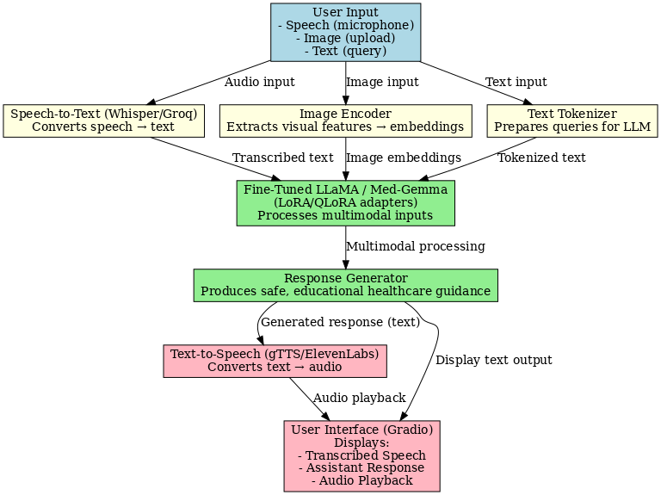
Flow Diagram
Figure 1 : Work Flow Diagram of project

Slide 12
5
Experimental Results
Speech-to-Text (STT) :
The STT module effectively transcribes patient voice queries .Handles medical terms + accents well.
Image Understanding :
The system generates meaningful descriptions of burns and cuts, suitable for educational support.
Language Model (LLM) Responses :
The model produces relevant, concise, and safe responses in conversational style.
Text-to-Speech (TTS) :
The generated speech output was perceived as clear and natural by users.
. User Study:
Users found the assistant effective for general healthcare queries and educational support.

Slide 13
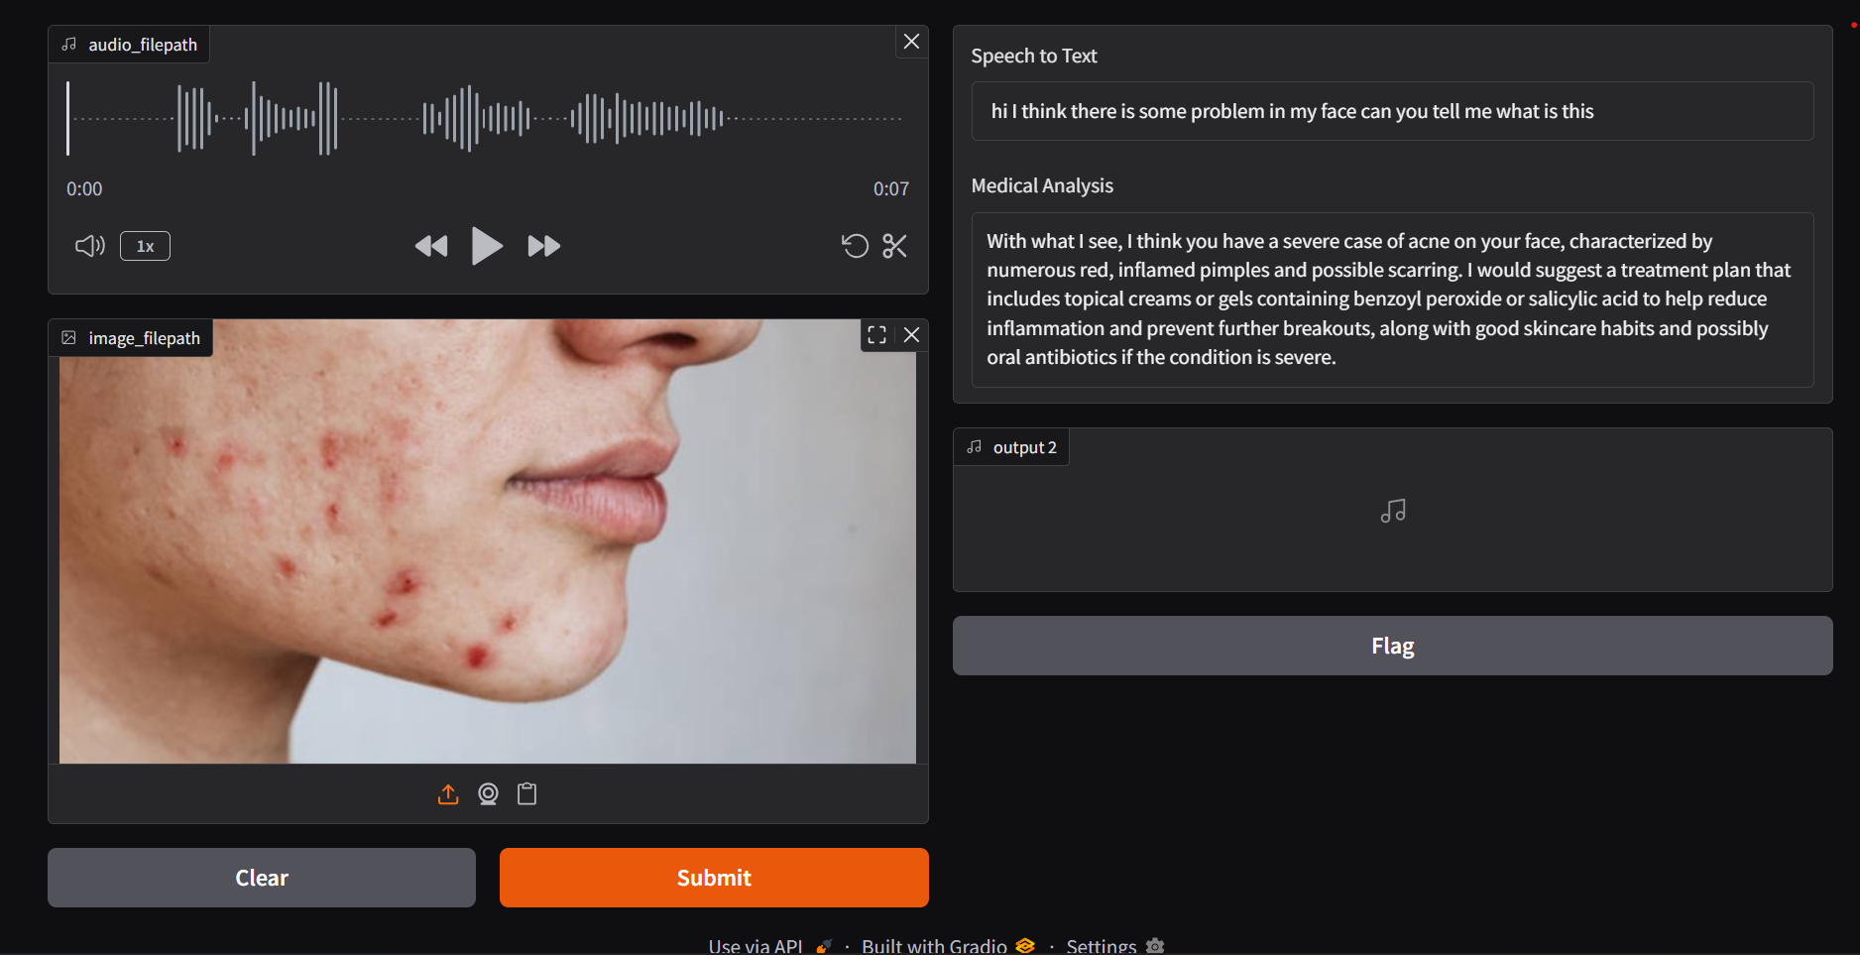
Output of Experimental Result :
Figure 2 : Experimental output Screen Shot

Slide 14
06
References
[1] Question Answering for Electronic Health Records: Scoping Review of Datasets and Models : https://www.jmir.org/2024/1/e53636.
[2] Applying generative AI with retrieval augmented generation to summarize and extract key clinical information from electronic health records. https://www.sciencedirect.com/science/article/pii/S1532046424000807.
[3] Applications of Generative Artificial Intelligence in Electronic Medical Records: A Scoping Review : https://www.mdpi.com/2078-2489/16/4/284#:~:text=This%20scoping%20review%20aims%20to%20explore%20the%20current,A%20literature%20search%20was%20conducted%20following%20PRISMA-ScR%20guidelines.
[4] Natural language processing techniques applied to the electronic health record in clinical research and practice - an introduction to methodologies: https://www.sciencedirect.com/science/article/pii/S0010482525001581#:~:text=Introduces%20natural%20language%20processing%20methods%20to%20analyse%20electronic,natural%20language%20processing%20experts%20and%20the%20clinical%20researcher.
[5] Large Language Models in Healthcare and Medical Applications: Areview : https://www.mdpi.com/2306-5354/12/6/631

Slide 15
THANK YOU

